Slide 1
CSE 201: Digital Logic Design
Prepared By
Lec Sumaiya Afroz Mila
CSE, MIST

Slide 2
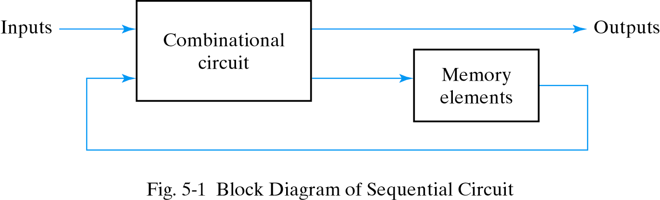
SEQUENTIAL CIRCUIT
Consist of a combinational circuit to which storage elements are connected to form a feedback path
The storage elements are devices capable of storing binary information.
State of a circuit: Binary information stored in these elements at any given time
The state of the memory devices now, also called current state
Next states and outputs are functions of inputs and present states of storage elements
Memory elements examples- latch, flip-flop

Slide 3
LATCH
Can store binary information(0 or 1) indefinitely (as long as power is provided)
Building block or basic circuit of other memory elements
Level-triggered memory element
Constructed with NOR gates or NAND gates

Slide 4
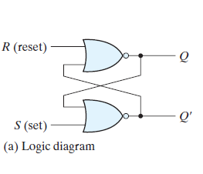
SR LATCH
S | R | Q | Q’
1 | 0 | 1 | 0
0 | 0 | 1 | 0
0 | 1 | 0 | 1
0 | 0 | 0 | 1
1 | 1 | Forbidden
Memory
Memory
Truth Table of NOR gate
A | B | F
0 | 0 | 1
0 | 1 | 0
1 | 0 | 0
1 | 1 | 0

Slide 5
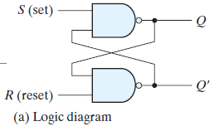
SR LATCH
S | R | Q | Q’
1 | 0 | 0 | 1
1 | 1 | 0 | 1
0 | 1 | 1 | 0
1 | 1 | 1 | 0
0 | 0 | Forbidden
Memory
Memory
Truth Table of NAND gate
A | B | F
0 | 0 | 1
0 | 1 | 1
1 | 0 | 1
1 | 1 | 0

Slide 6
TWO TYPES OF SEQUENTIAL CIRCUIT
Asynchronous sequential circuit
Depends upon the input signals at any instant of time and their change order
Hard to design
Works faster as there is no clock
Status of the memory element is affected any time as soon as the input is changed
Example - Latch
Synchronous sequential circuit
Defined from the knowledge of its signals at discrete instants of time
Much easier to design
Works slower
Status of the memory element is affected only at the active edge of clock if input is changed
Example – flip flop

Slide 7
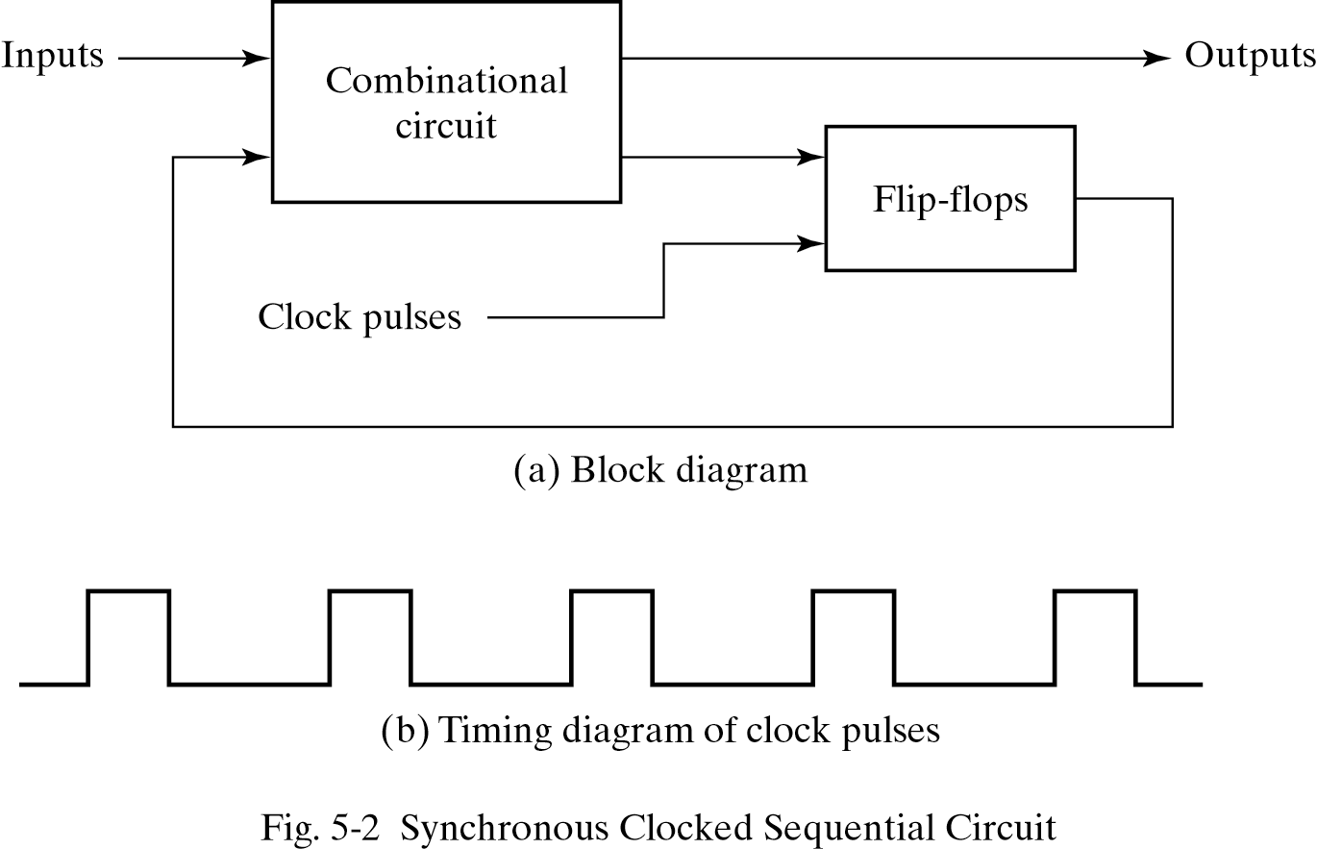
SYNCHRONOUS CLOCKED SEQUENTIAL CIRCUIT

Slide 8
MEMORY ELEMENTS
Latch - a level-sensitive memory element
Examples -
SR latches
D latches
Flip-Flop - an edge-triggered memory element
Examples-
Master-slave flip-flop
Edge-triggered flip-flop
RAM and ROM  a mass memory element
C
CLK
Positive Edge
CLK
Negative Edge

Slide 9
SR FLIP-FLOP

Slide 10
SR FLIP FLOP
S | R | Q | Q’
1 | 0 | 0 | 1
1 | 1 | 0 | 1
0 | 1 | 1 | 0
1 | 1 | 1 | 0
0 | 0 | Invalid
Memory
Memory
S | R | Q | Q’
0 | 0 | Invalid
0 | 1 | 1 | 0
1 | 0 | 0 | 1
1 | 1 | Memory

Slide 11
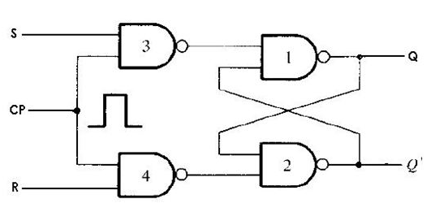
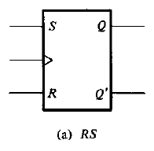
SR FLIP FLOP
S*
S* | R* | Q | Q’
0 | 0 | Invalid
0 | 1 | 1 | 0
1 | 0 | 0 | 1
1 | 1 | Memory
R*
S* = (S . CP) ‘
= S’ + CP’
Graphic symbol of SR flip flop
R* = (R . CP) ‘
= R’ + CP’
CP | S | R | Q | Q’
0 | x | x | Memory
1 | 0 | 0 | Memory
1 | 0 | 1 | 0 | 1
1 | 1 | 0 | 1 | 0
1 | 1 | 1 | Invalid

Slide 12
SR FLIP FLOP
Truth Table of SR flip flop
Characteristics Table of SR flip flop
Excitation Table of SR flip flop
CP | S | R | Q_{t+1}
0 | x | x | Q_{t}
1 | 0 | 0 | Q_{t}
1 | 0 | 1 | 0
1 | 1 | 0 | 1
1 | 1 | 1 | Invalid
Q_{t} | S | R | Q_{t+1}
0 | 0 | 0 | 0
0 | 0 | 1 | 0
0 | 1 | 0 | 1
0 | 1 | 1 | invalid
1 | 0 | 0 | 1
1 | 0 | 1 | 0
1 | 1 | 0 | 1
1 | 1 | 1 | invalid
Q_{t} | Q_{t+1} | S | R
0 | 0 | 0 | X
0 | 1 | 1 | 0
1 | 0 | 0 | 1
1 | 1 | X | 0

Slide 13
SR FLIP FLOP
Characteristics Table of SR flip flop
Characteristics Equation of SR flip flop
SR
Q_{t} | S | R | Q_{t+1}
0 | 0 | 0 | 0
0 | 0 | 1 | 0
0 | 1 | 0 | 1
0 | 1 | 1 | invalid
1 | 0 | 0 | 1
1 | 0 | 1 | 0
1 | 1 | 0 | 1
1 | 1 | 1 | invalid
Q_{t}
00
01
11
10
0
0 | 0 | X | 1
1 | 0 | X | 1
1
Q_{t+1} = S + Q_{t}R’
What is the value of Q’_{t+1}?

Slide 14
SR FLIP FLOP
Excitation Table of SR flip flop
Q_{t} | Q_{t+1} | S | R
0 | 0 | 0 | X
0 | 1 | 1 | 0
1 | 0 | 0 | 1
1 | 1 | X | 0
Similarly find the value of S and R

Slide 15
D FLIP-FLOP

Slide 16
SR LATCH with NAND GATE
S | R | Q | Q’
1 | 0 | 0 | 1
1 | 1 | 0 | 1
0 | 1 | 1 | 0
1 | 1 | 1 | 0
0 | 0 | Invalid
Memory
Memory
S | R | Q | Q’
0 | 0 | Invalid
0 | 1 | 1 | 0
1 | 0 | 0 | 1
1 | 1 | Memory

Slide 17
LIMITATIONS in SR FLIP FLOP
It has an invalid input combination. Circuit gives unexpected outcome if such combination occurs. In D flip-flop this combination is eliminated.
S* | R* | Q | Q’
0 | 0 | Invalid
0 | 1 | 1 | 0
1 | 0 | 0 | 1
1 | 1 | Memory
S*
CP | S | R | Q | Q’
0 | x | x | Memory
1 | 0 | 0 | Memory
1 | 0 | 1 | 0 | 1
1 | 1 | 0 | 1 | 0
1 | 1 | 1 | Invalid
R*

Slide 18
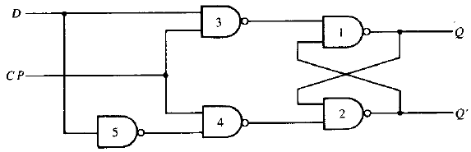
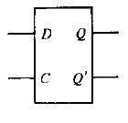
D (DATA) FLIP FLOP
Truth Table of SR flip flop
Truth Table of D flip flop
Same as SR flip flop
S*
CP | S | R | Q_{t+1}
0 | x | x | Q_{t}
1 | 0 | 0 | Q_{t}
1 | 0 | 1 | 0
1 | 1 | 0 | 1
1 | 1 | 1 | Invalid
CLK | D | Q_{t+1}
0 | X | Q_{t}
1 | 0 | 0
1 | 1 | 1
R*
Graphic symbol of SR flip flop

Slide 19
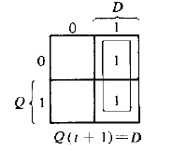
D FLIP FLOP
Truth Table of D flip flop
Characteristics Table of D flip flop
Excitation Table of D flip flop
Q_{t} | D | Q_{t+1}
0 | 0 | 0
0 | 1 | 1
1 | 0 | 0
1 | 1 | 1
Q_{t} | Q_{t+1} | D
0 | 0 | 0
0 | 1 | 1
1 | 0 | 0
1 | 1 | 1
CLK | D | Q_{t+1}
0 | X | Q_{t}
1 | 0 | 0
1 | 1 | 1

Slide 20
JK FLIP-FLOP

Slide 21
SR LATCH with NOR GATE
S | R | Q | Q’
1 | 0 | 1 | 0
0 | 0 | 1 | 0
0 | 1 | 0 | 1
0 | 0 | 0 | 1
1 | 1 | Forbidden
Memory
Memory
Truth Table of NOR gate
A | B | F
0 | 0 | 1
0 | 1 | 0
1 | 0 | 0
1 | 1 | 0

Slide 22
SR LATCH
S | R | Q | Q’
1 | 0 | 1 | 0
0 | 0 | 1 | 0
0 | 1 | 0 | 1
0 | 0 | 0 | 1
1 | 1 | Forbidden
Memory
Memory
S | R | Q | Q’
0 | 0 | Memory
0 | 1 | 0 | 1
1 | 0 | 1 | 0
1 | 1 | Forbidden

Slide 23
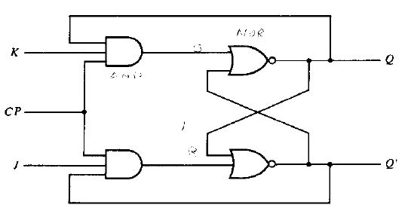
JK FLIP FLOP
Characteristics Table of JK flip flop
Q | J | K | Q(t+1)
0 | 0 | 0 | 0
0 | 0 | 1 | 0
0 | 1 | 0 | 1
0 | 1 | 1 | 1
1 | 0 | 0 | 1
1 | 0 | 1 | 0
1 | 1 | 0 | 1
1 | 1 | 1 | 0
R*
S*
R* = Q.K.CP
S* = Q’. J.CP
S* | R* | Q | Q’
0 | 0 | Memory
0 | 1 | 0 | 1
1 | 0 | 1 | 0
1 | 1 | Forbidden

Slide 24
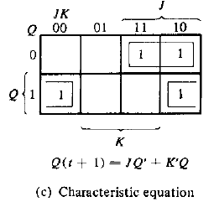
JK FLIP FLOP
Characteristics Table of JK flip flop
Excitation Table of JK flip flop
Q | J | K | Q(t+1)
0 | 0 | 0 | 0
0 | 0 | 1 | 0
0 | 1 | 0 | 1
0 | 1 | 1 | 1
1 | 0 | 0 | 1
1 | 0 | 1 | 0
1 | 1 | 0 | 1
1 | 1 | 1 | 0
Q_{t} | Q_{t+1} | J | K
0 | 0 | 0 | X
0 | 1 | 1 | X
1 | 0 | X | 1
1 | 1 | X | 0

Slide 25
T FLIP-FLOP

Slide 26
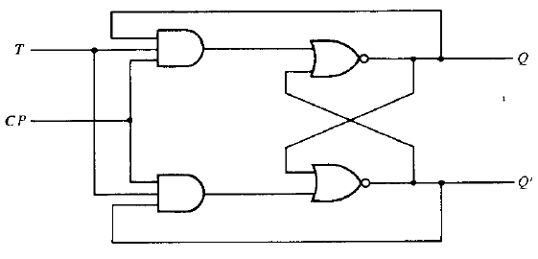
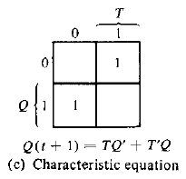
T FLIP FLOP
Characteristics Table of JK flip flop
Q | T | Q(t+1)
0 | 0 | 0
0 | 1 | 1
1 | 0 | 1
1 | 1 | 0
R*
S*
S* = Q’.T.CP
Excitation Table of D flip flop
R* = Q. T.CP
Q_{t} | Q_{t+1} | D
0 | 0 | 0
0 | 1 | 1
1 | 0 | 1
1 | 1 | 0
S* | R* | Q | Q’
0 | 0 | Memory
0 | 1 | 0 | 1
1 | 0 | 1 | 0
1 | 1 | Forbidden

Slide 27
Analysis of Sequential Circuit

Slide 28
Analysis of Clocked Sequential Circuits: Terminology
STATE EQUATION : A state equation is an algebraic expression that specifies the conditions for a flip-flop state transition.
Left side of the equation denotes the next state and right side is a boolean function that specifies the present state conditions that make the next state equal to 1.
STATE TABLE : A state table consists of 3 sections – Present state, Next state and output(if there is any). [We will need the characteristics table to form state table]
STATE DIAGRAM: The information in a state table can be represented graphically in a state diagram.
The state is represented by a circle and the transitions between states are indicated by directed lines connecting the circles.

Slide 29
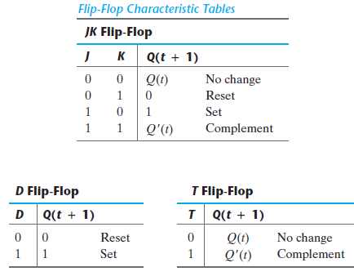
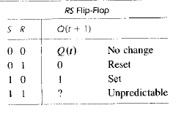
Characteristics Tables

Slide 30
Steps for Analyzing Clocked Sequential Circuits
At first, find out the flip-flop specified in the question
Derive the input equation of the circuit
Generate the state table with the help of input equation and characteristics table of that flip-flop
Derive the state equation from the state table
Draw the state diagram from the state table

Slide 31
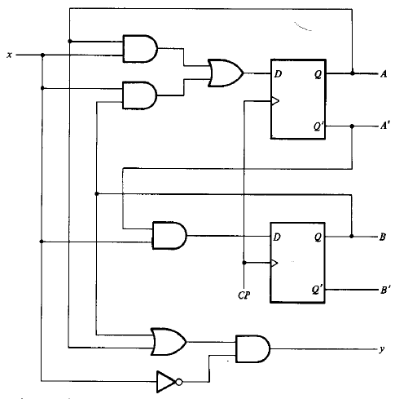
Analysis of Clocked Sequential Circuits: Example 1
You are given a circuit. Analyse it.

Slide 32
Analysis of Clocked Sequential Circuits: Example 1
Input Equation:
D_{A} = A(t)x(t) + B(t)x(t)
D_{B} = A’(t)x(t)
Y = [A+B] x’
State Table
Present State |  | Input | Next State |  | Flip Flop Inputs |  | Output
A | B | x | A_{t+1} | B_{t+1} | D_{A} | D_{B} | y
0 | 0 | 0 | 0 | 0 | 0 | 0 | 0
0 | 0 | 1 | 0 | 1 | 0 | 1 | 0
0 | 1 | 0 | 0 | 0 | 0 | 0 | 1
0 | 1 | 1 | 1 | 1 | 1 | 1 | 0
1 | 0 | 0 | 0 | 0 | 0 | 0 | 1
1 | 0 | 1 | 1 | 0 | 1 | 0 | 0
1 | 1 | 0 | 0 | 0 | 0 | 0 | 1
1 | 1 | 1 | 1 | 0 | 1 | 0 | 0

Slide 33
Analysis of Clocked Sequential Circuits: Example 1 Cntd.
Input Equation:
D_{A} = A(t)x(t) + B(t)x(t)
D_{B} = A’(t)x(t)
Y = [A+B] x’
State Equation
A(t+1):
State Table
BX
01
A
00
11
10
Present State |  | Input | Next State |  | Flip Flop Inputs |  | Output
A | B | x | A_{t+1} | B_{t+1} | D_{A} | D_{B} | y
0 | 0 | 0 | 0 | 0 | 0 | 0 | 0
0 | 0 | 1 | 0 | 1 | 0 | 1 | 0
0 | 1 | 0 | 0 | 0 | 0 | 0 | 1
0 | 1 | 1 | 1 | 1 | 1 | 1 | 0
1 | 0 | 0 | 0 | 0 | 0 | 0 | 1
1 | 0 | 1 | 1 | 0 | 1 | 0 | 0
1 | 1 | 0 | 0 | 0 | 0 | 0 | 1
1 | 1 | 1 | 1 | 0 | 1 | 0 | 0
0
0 | 0 | 1 | 0
0 | 1 | 1 | 0
1
A(t+1): Bx + Ax
B(t+1):
BX
01
A
00
11
10
0
0 | 1 | 1 | 0
0 | 0 | 0 | 0
1
B(t+1): A’x

Slide 34
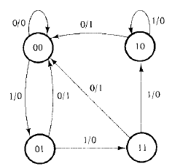
Analysis of Clocked Sequential Circuits: Example 1 Cntd.
Input Equation:
D_{A} = A(t)x(t) + B(t)x(t)
D_{B} = A’(t)x(t)
Y = [A+B] x’
State Diagram
State Table
Present State |  | Input | Next State |  | Flip Flop Inputs |  | Output
A | B | x | A_{t+1} | B_{t+1} | D_{A} | D_{B} | y
0 | 0 | 0 | 0 | 0 | 0 | 0 | 0
0 | 0 | 1 | 0 | 1 | 0 | 1 | 0
0 | 1 | 0 | 0 | 0 | 0 | 0 | 1
0 | 1 | 1 | 1 | 1 | 1 | 1 | 0
1 | 0 | 0 | 0 | 0 | 0 | 0 | 1
1 | 0 | 1 | 1 | 0 | 1 | 0 | 0
1 | 1 | 0 | 0 | 0 | 0 | 0 | 1
1 | 1 | 1 | 1 | 0 | 1 | 0 | 0

Slide 35

Analysis of Clocked Sequential Circuits: Example 2
Input Equation:
You are given input equations of a circuit. Analyse it.

Slide 36
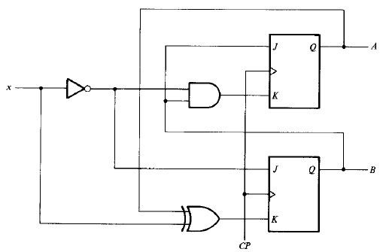
Analysis of Clocked Sequential Circuits: Example 2 Cntd.
Input Equation:

Slide 37
Analysis of Clocked Sequential Circuits: Example 2 Cntd.
Input Equation:
A(t+1):
BX
01
A
00
11
10
State Table
0
0 | 0 | 1 | 1
1 | 1 | 1 | 0
Present State |  | Input | Next State |  | Flip Flop Inputs
A | B | x | A_{t+1} | B_{t+1} | J_{A} | K_{A} | J_{B} | K_{B}
0 | 0 | 0 | 0 | 1 | 0 | 0 | 1 | 0
0 | 0 | 1 | 0 | 0 | 0 | 0 | 0 | 1
0 | 1 | 0 | 1 | 1 | 1 | 1 | 1 | 0
0 | 1 | 1 | 1 | 0 | 1 | 0 | 0 | 1
1 | 0 | 0 | 1 | 1 | 0 | 0 | 1 | 1
1 | 0 | 1 | 1 | 0 | 0 | 0 | 0 | 0
1 | 1 | 0 | 0 | 0 | 1 | 1 | 1 | 1
1 | 1 | 1 | 1 | 1 | 1 | 0 | 0 | 0
1
A(t+1): A’B + Ax + AB’
B(t+1):
BX
11
10
A
00
01
0
1 | 0 | 0 | 1
1 | 0 | 1 | 0
1
B(t+1): B’x’ + A’x’ + ABx

Slide 38
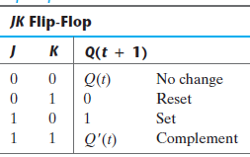
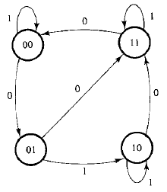
Analysis of Clocked Sequential Circuits: Example 2 Cntd.
Input Equation:
State Table
Present State |  | Input | Next State |  | Flip Flop Inputs
A | B | x | A_{t+1} | B_{t+1} | J_{A} | K_{A} | J_{B} | K_{B}
0 | 0 | 0 | 0 | 1 | 0 | 0 | 1 | 0
0 | 0 | 1 | 0 | 0 | 0 | 0 | 0 | 1
0 | 1 | 0 | 1 | 1 | 1 | 1 | 1 | 0
0 | 1 | 1 | 1 | 0 | 1 | 0 | 0 | 1
1 | 0 | 0 | 1 | 1 | 0 | 0 | 1 | 1
1 | 0 | 1 | 1 | 0 | 0 | 0 | 0 | 0
1 | 1 | 0 | 0 | 0 | 1 | 1 | 1 | 1
1 | 1 | 1 | 1 | 1 | 1 | 0 | 0 | 0

Slide 39
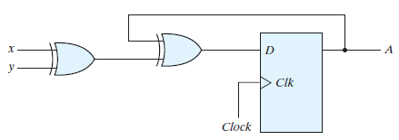

Analysis of Clocked Sequential Circuits: Example 3
Input Equation:
State Table
Present State | Input |  | Next State | Flip Flop Inputs
A | x | y | A_{t+1} | D_{A}
0 | 0 | 0 | 0 | 0
0 | 0 | 1 | 1 | 1
0 | 1 | 0 | 1 | 1
0 | 1 | 1 | 0 | 0
1 | 0 | 0 | 1 | 1
1 | 0 | 1 | 0 | 0
1 | 1 | 0 | 0 | 0
1 | 1 | 1 | 1 | 1

Slide 40

Analysis of Clocked Sequential Circuits: Example 3 Cntd.
Input Equation:
State Table
Present State | Input |  | Next State | Flip Flop Inputs
A | x | y | A_{t+1} | D_{A}
0 | 0 | 0 | 0 | 0
0 | 0 | 1 | 1 | 1
0 | 1 | 0 | 1 | 1
0 | 1 | 1 | 0 | 0
1 | 0 | 0 | 1 | 1
1 | 0 | 1 | 0 | 0
1 | 1 | 0 | 0 | 0
1 | 1 | 1 | 1 | 1
XY
01
A
00
11
10
0
0 | 1 | 0 | 1
1 | 0 | 1 | 0
1
A(t+1): A’x’y + A’xy’+Ax’y’+ Axy
= A’ (x’y+xy’) + A (x’y’+xy)
= A’ (x xor y) + A (x xnor y)
= A xor x xor y

Slide 41

Analysis of Clocked Sequential Circuits: Example 4(self study)
Input Equation:
Try analyzing a circuit containing the above input equation
ANSWER
A(t+1)=A’Bx+AB’+Ax’
B(t+1)=B’x+Bx’

Slide 42
State Reduction & Assignment

Slide 43
State Reduction
State reduction is required to minimize the cost of the final circuit
State reduction algorithms are concerned with procedures for reducing the number of states in a state table without affecting the input-output sequence
Two circuits are said to be equivalent:
If identical outputs occur for all input sequences
Number of states is not important
An algorithm for state reduction:
Two states are said to be equivalent
For each member of the set of inputs, they give exactly the same output and send the circuit to the same state or to an equivalent state.
One of them can be removed without altering the input output relations

Slide 44
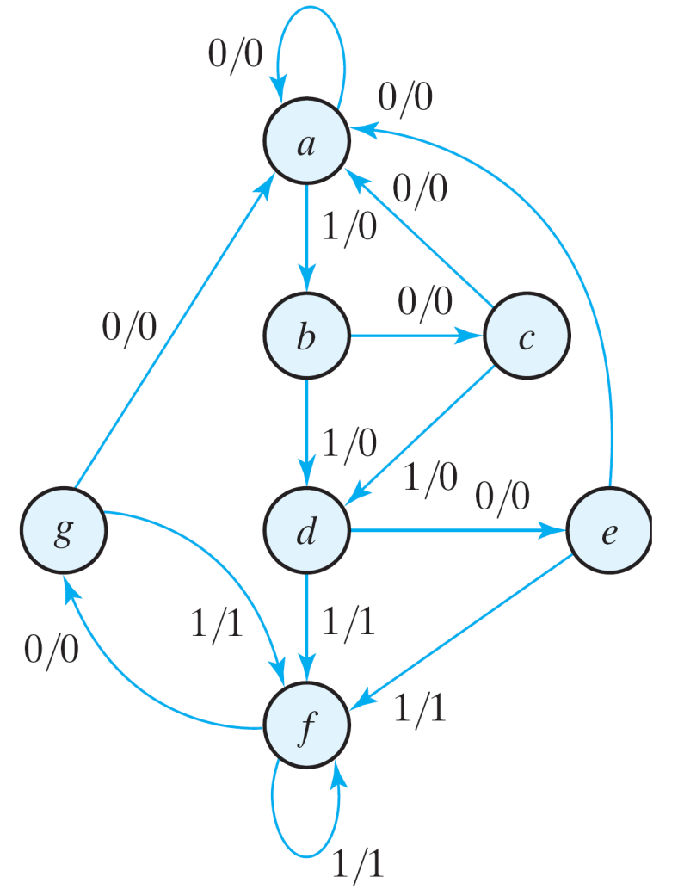

State Reduction Example 1
Total states : 7
Consider an Input sequence: 0 1 0 1 0 1 1 0 1 0 0, starting with a, The complete sequence will be:
If we can find a circuit whose state diagram has less than 7 states, and identical outputs occur for the above input sequence and all other possible sequences, then the two circuits are said to be equivalent

Slide 45
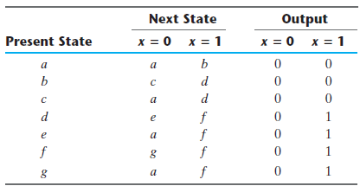
State Reduction Example 1
We will apply the algorithm to this state table
Look for two present states that go to the same next state and have the same output for both input combinations
1. e = g (remove g);
2. Replace all g by e

Slide 46
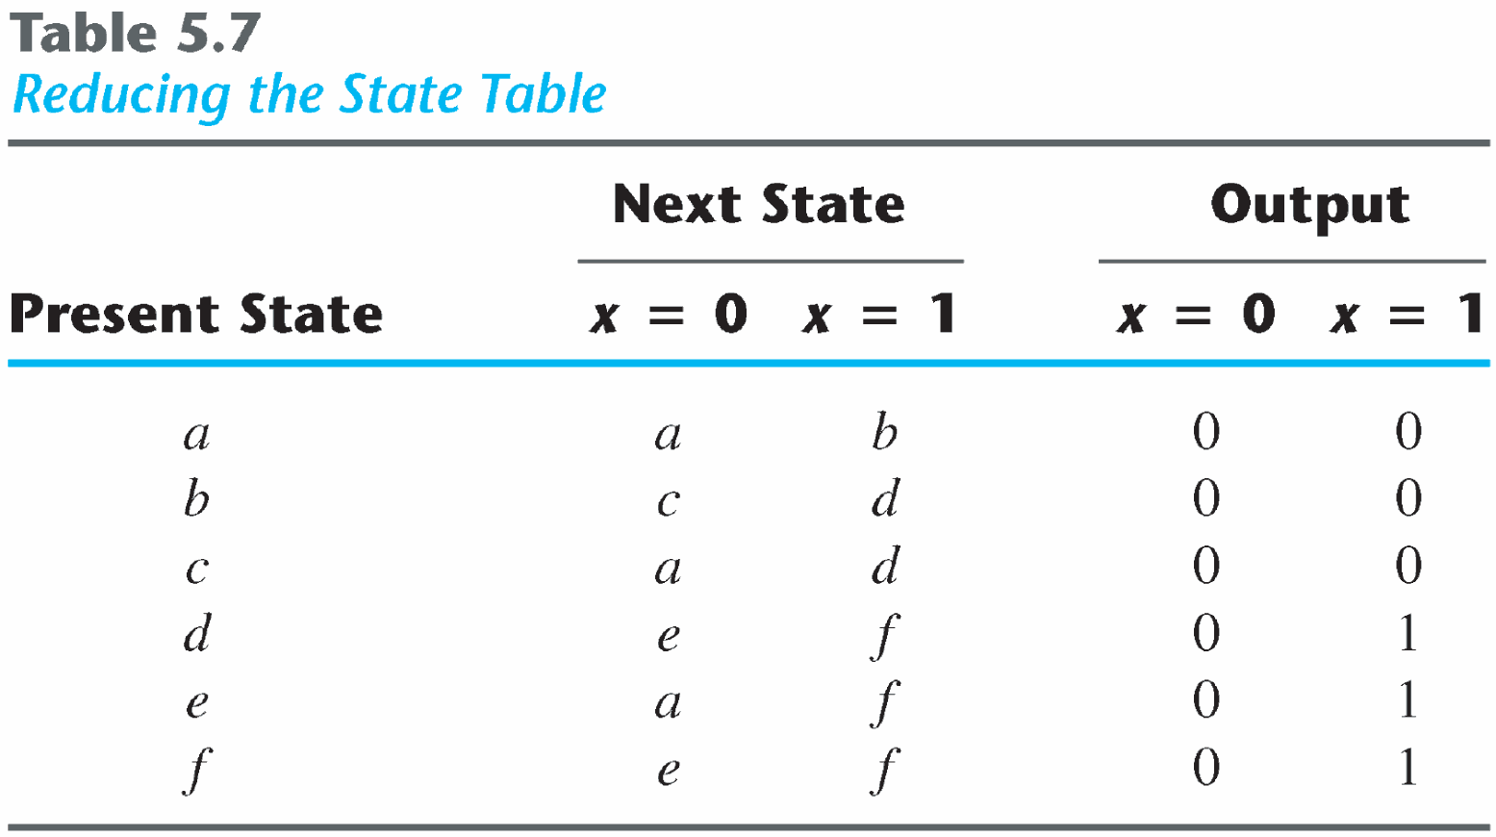
State Reduction Example 1
d = f (remove f);

Slide 47
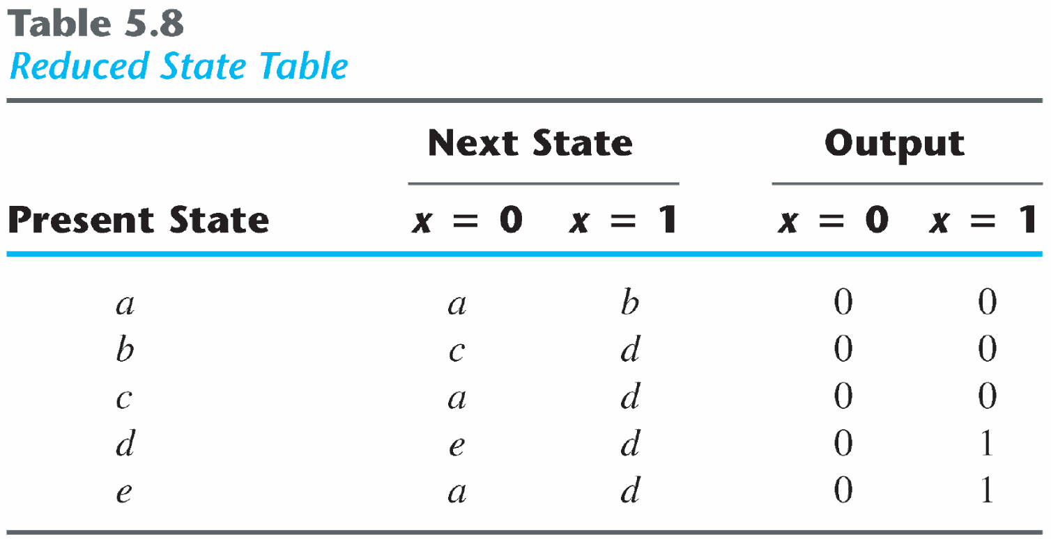

State Reduction Example 1
Reduced state table
New output and state sequence for the previous input sequence: 0 1 0 1 0 1 1 0 1 0 0

Slide 48
State Reduction Example 1
Previous state Sequence
New state Sequence

Slide 49
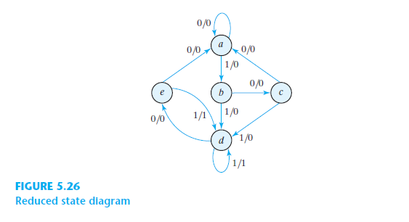
State Reduction Example 1
Reduced state Diagram

Slide 50
State Reduction Example 2
Present State | Next State |  | Output
 | X=0 | X=1 | X=0 | X=1
A | F | B | 0 | 0
B | D | C | 0 | 0
C | F | E | 0 | 0
D | G | A | 1 | 0
E | D | C | 0 | 0
F | F | B | 1 | 1
G | G | D | 0 | 1

Slide 51
State Assignment
Assign coded binary values to the states for physical implementation
For a circuit with m states, the codes must contain n bits where 2^{n} >= m
Unused states are treated as don’t care conditions during the design
Don’t cares can help to obtain a simpler circuit
There are many possible state assignments
Have large impacts on the final circuit size

Slide 52
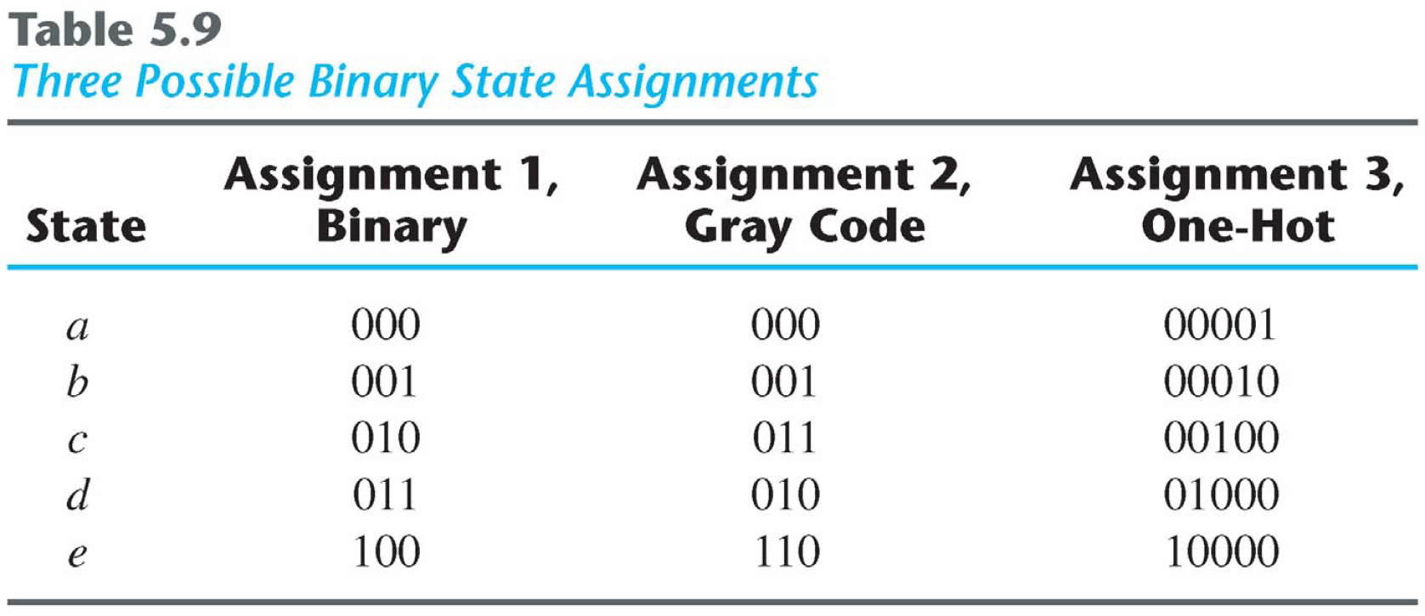
Popular State Assignment

Slide 53
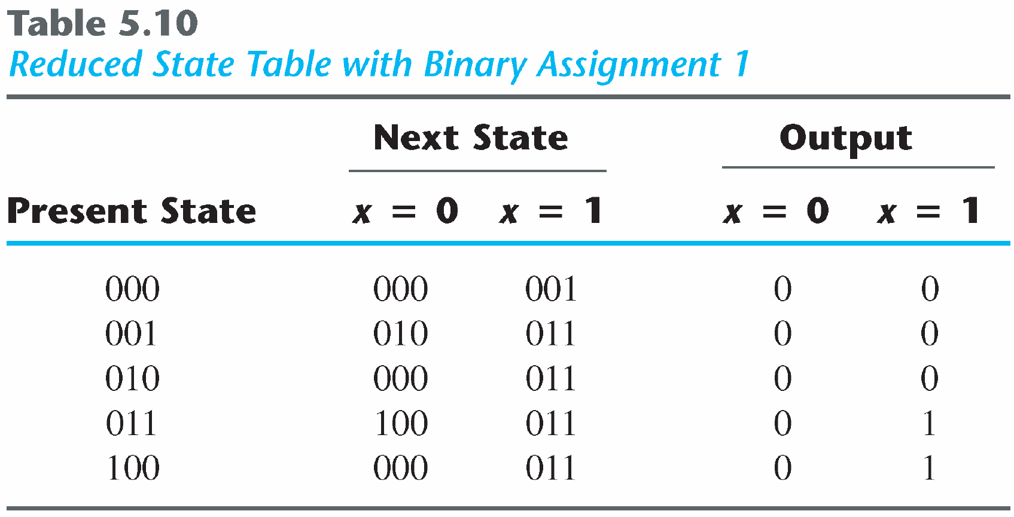
State Assignment
Any binary number assignment is satisfactory as long as each state is assigned a unique number
Use binary assignment 1

Slide 54
Mealy and Moore Model

Slide 55
Mealy and Moore Model
All the sequential circuits have input, output and internal states
Sequential circuits can be divided into two types based on their characteristics:
Mealy Model of sequential circuits
&
Moore Model of sequential circuits
They differ only in the way their output is generated
Mealy Model: The output is a function of both the present state and the input
Moore Model: The output is a function of only the present state

Slide 56
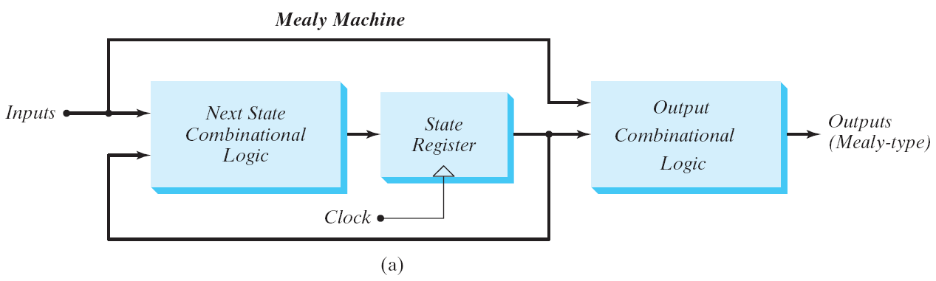
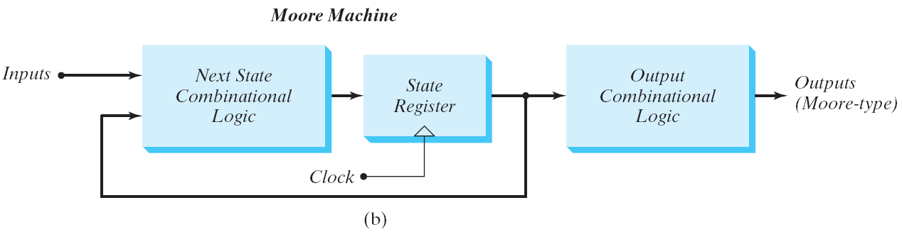
Block Diagram of Mealy and Moore Machine

Slide 57
Example of Mealy Machine
This circuit is an example of Mealy Machine
Present State |  | Input | Next State |  | Flip Flop Inputs |  | Output
A | B | x | A_{t+1} | B_{t+1} | D_{A} | D_{B} | y
0 | 0 | 0 | 0 | 0 | 0 | 0 | 0
0 | 0 | 1 | 0 | 1 | 0 | 1 | 0
0 | 1 | 0 | 0 | 0 | 0 | 0 | 1
0 | 1 | 1 | 1 | 1 | 1 | 1 | 0
1 | 0 | 0 | 0 | 0 | 0 | 0 | 1
1 | 0 | 1 | 1 | 0 | 1 | 0 | 0
1 | 1 | 0 | 0 | 0 | 0 | 0 | 1
1 | 1 | 1 | 1 | 0 | 1 | 0 | 0

Slide 58
Example of Mealy Machine
Present State |  | Input | Next State |  | Flip Flop Inputs |  | Output
A | B | x | A_{t+1} | B_{t+1} | D_{A} | D_{B} | y
0 | 0 | 0 | 0 | 0 | 0 | 0 | 0
0 | 0 | 1 | 0 | 1 | 0 | 1 | 0
0 | 1 | 0 | 0 | 0 | 0 | 0 | 1
0 | 1 | 1 | 1 | 1 | 1 | 1 | 0
1 | 0 | 0 | 0 | 0 | 0 | 0 | 1
1 | 0 | 1 | 1 | 0 | 1 | 0 | 0
1 | 1 | 0 | 0 | 0 | 0 | 0 | 1
1 | 1 | 1 | 1 | 0 | 1 | 0 | 0
The output y is a function of both present state AB and input x.
For present state 01
when input x=0; output is 1
when input x=1; output is 0
For the same state, the output changes with the input

Slide 59
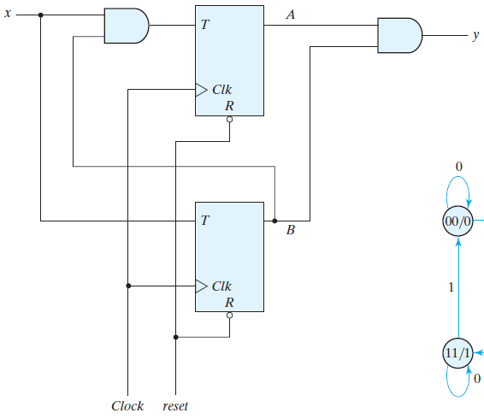
Example of Moore Machine
This circuit is an example of Moore Machine
Present State |  | Input | Next State |  | Flip Flop Inputs |  | Output
A | B | x | A_{t+1} | B_{t+1} | T_{A} | T_{B} | y
0 | 0 | 0 | 0 | 0 | 0 | 0 | 0
0 | 0 | 1 | 0 | 1 | 0 | 1 | 0
0 | 1 | 0 | 0 | 1 | 0 | 0 | 0
0 | 1 | 1 | 1 | 0 | 1 | 1 | 0
1 | 0 | 0 | 1 | 0 | 0 | 0 | 0
1 | 0 | 1 | 1 | 1 | 0 | 1 | 0
1 | 1 | 0 | 1 | 1 | 0 | 0 | 1
1 | 1 | 1 | 0 | 0 | 1 | 1 | 1

Slide 60
Example of Mealy Machine
The output y is a function of only present state AB
For present state 01
when input x=0; output is 0
when input x=1; output is 0
This is same for all the combinations
For the same state, the output does not change with the input
Present State |  | Input | Next State |  | Flip Flop Inputs |  | Output
A | B | x | A_{t+1} | B_{t+1} | T_{A} | T_{B} | y
0 | 0 | 0 | 0 | 0 | 0 | 0 | 0
0 | 0 | 1 | 0 | 1 | 0 | 1 | 0
0 | 1 | 0 | 0 | 1 | 0 | 0 | 0
0 | 1 | 1 | 1 | 0 | 1 | 1 | 0
1 | 0 | 0 | 1 | 0 | 0 | 0 | 0
1 | 0 | 1 | 1 | 1 | 0 | 1 | 0
1 | 1 | 0 | 1 | 1 | 0 | 0 | 1
1 | 1 | 1 | 0 | 0 | 1 | 1 | 1

Slide 61
Design of Sequential Circuit

Slide 62
Steps of Design Procedure
Derive a state diagram for the circuit
Reduce the number of states if necessary
Assign binary values to the states
Obtain the binary coded state table
Choose the type of flip flop to be used
Derive the simplified flip flop input equation and output equation
Draw the logic diagram

Slide 63
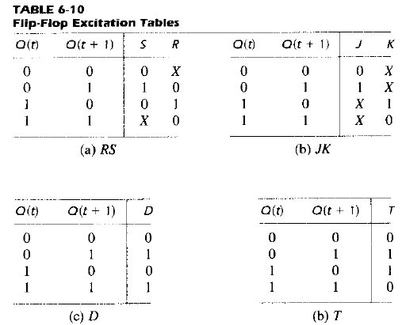
Excitation Tables

Slide 64
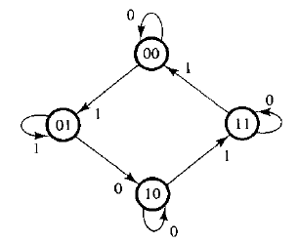
Example 1: State Diagram For Design
State Table for Circuit Design
Present State |  | Input | Next State
A | B | x | A_{t+1} | B_{t+1}
0 | 0 | 0 | 0 | 0
0 | 0 | 1 | 0 | 1
0 | 1 | 0 | 1 | 0
0 | 1 | 1 | 0 | 1
1 | 0 | 0 | 1 | 0
1 | 0 | 1 | 1 | 1
1 | 1 | 0 | 1 | 1
1 | 1 | 1 | 0 | 0

Slide 65
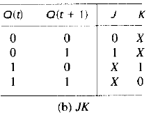
Example 1: State Diagram For Design
Let’s design the circuit with JK flip flop first
Present State |  | Input | Next State |  | Flip Flop Inputs
A | B | x | A_{t+1} | B_{t+1} | J_{A} | K_{A} | J_{B} | K_{B}
0 | 0 | 0 | 0 | 0 | 0 | X | 0 | X
0 | 0 | 1 | 0 | 1 | 0 | X | 1 | X
0 | 1 | 0 | 1 | 0 | 1 | X | X | 1
0 | 1 | 1 | 0 | 1 | 0 | X | X | 0
1 | 0 | 0 | 1 | 0 | X | 0 | 0 | X
1 | 0 | 1 | 1 | 1 | X | 0 | 1 | X
1 | 1 | 0 | 1 | 1 | X | 0 | X | 0
1 | 1 | 1 | 0 | 0 | X | 1 | X | 1

Slide 66
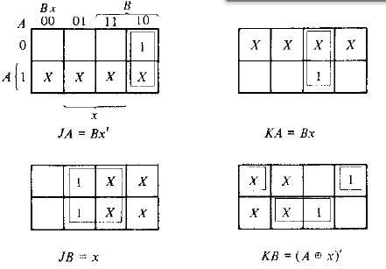
Example 1: State Diagram For Design
Present State |  | Input | Next State |  | Flip Flop Inputs
A | B | x | A_{t+1} | B_{t+1} | J_{A} | K_{A} | J_{B} | K_{B}
0 | 0 | 0 | 0 | 0 | 0 | X | 0 | X
0 | 0 | 1 | 0 | 1 | 0 | X | 1 | X
0 | 1 | 0 | 1 | 0 | 1 | X | X | 1
0 | 1 | 1 | 0 | 1 | 0 | X | X | 0
1 | 0 | 0 | 1 | 0 | X | 0 | 0 | X
1 | 0 | 1 | 1 | 1 | X | 0 | 1 | X
1 | 1 | 0 | 1 | 1 | X | 0 | X | 0
1 | 1 | 1 | 0 | 0 | X | 1 | X | 1

Slide 67
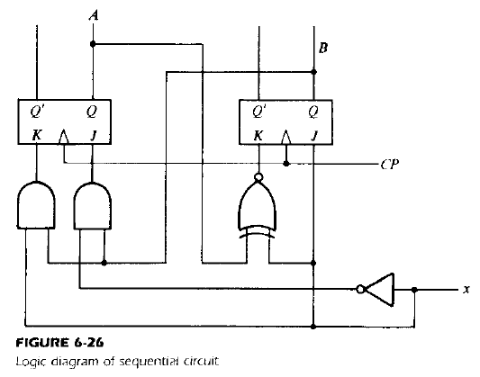
Example 1: State Diagram For Design

Slide 68
Example 2: State Diagram For Design
State Table for Circuit Design
Present State |  | Input | Next State
A | B | x | A_{t+1} | B_{t+1}
0 | 0 | 0 | 0 | 0
0 | 0 | 1 | 0 | 1
0 | 1 | 0 | 1 | 0
0 | 1 | 1 | 0 | 1
1 | 0 | 0 | 1 | 0
1 | 0 | 1 | 1 | 1
1 | 1 | 0 | 1 | 1
1 | 1 | 1 | 0 | 0

Slide 69
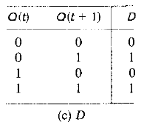
Example: 2 State Diagram For Design
Let’s design the circuit with D flip flop first
Present State |  | Input | Next State |  | Flip Flop Inputs
A | B | x | A_{t+1} | B_{t+1} | D_{A} | D_{B}
0 | 0 | 0 | 0 | 0 | 0 | 0
0 | 0 | 1 | 0 | 1 | 0 | 1
0 | 1 | 0 | 1 | 0 | 1 | 0
0 | 1 | 1 | 0 | 1 | 0 | 1
1 | 0 | 0 | 1 | 0 | 1 | 0
1 | 0 | 1 | 1 | 1 | 1 | 1
1 | 1 | 0 | 1 | 1 | 1 | 1
1 | 1 | 1 | 0 | 0 | 0 | 0

Slide 70
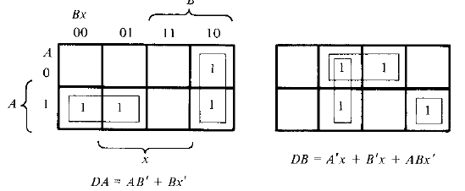
Example 2: State Diagram For Design
Present State |  | Input | Next State |  | Flip Flop Inputs
A | B | x | A_{t+1} | B_{t+1} | D_{A} | D_{B}
0 | 0 | 0 | 0 | 0 | 0 | 0
0 | 0 | 1 | 0 | 1 | 0 | 1
0 | 1 | 0 | 1 | 0 | 1 | 0
0 | 1 | 1 | 0 | 1 | 0 | 1
1 | 0 | 0 | 1 | 0 | 1 | 0
1 | 0 | 1 | 1 | 1 | 1 | 1
1 | 1 | 0 | 1 | 1 | 1 | 1
1 | 1 | 1 | 0 | 0 | 0 | 0

Slide 71
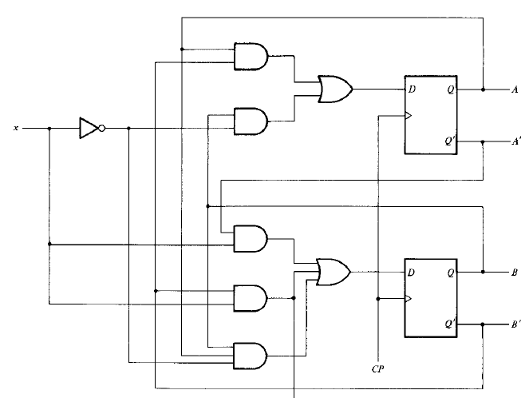
Example 2: State Diagram For Design

Slide 72
Example 3: State Diagram For Design
0/0
Present State |  | Input | Next State |  | Output
A | B | x | A_{t+1} | B_{t+1} | Y
0 | 0 | 0 | 0 | 0 | 0
0 | 0 | 1 | 0 | 1 | 1
0 | 1 | 0 | 1 | 0 | 0
0 | 1 | 1 | 0 | 1 | 0
1 | 0 | 0 | 1 | 0 | 0
1 | 0 | 1 | 1 | 1 | 1
1 | 1 | 0 | 1 | 1 | 0
1 | 1 | 1 | 0 | 0 | 0
1/0
0/0
1/1
1/0
1/1
0/0
0/0

Slide 73
Example 3: State Diagram For Design
Let’s design the circuit with D flip flop first
Present State |  | Input | Next State |  | Flip Flop Inputs |  | Output
A | B | x | A_{t+1} | B_{t+1} | D_{A} | D_{B} | Y
0 | 0 | 0 | 0 | 0 | 0 | 0 | 0
0 | 0 | 1 | 0 | 1 | 0 | 1 | 1
0 | 1 | 0 | 1 | 0 | 1 | 0 | 0
0 | 1 | 1 | 0 | 1 | 0 | 1 | 0
1 | 0 | 0 | 1 | 0 | 1 | 0 | 0
1 | 0 | 1 | 1 | 1 | 1 | 1 | 1
1 | 1 | 0 | 1 | 1 | 1 | 1 | 0
1 | 1 | 1 | 0 | 0 | 0 | 0 | 0

Slide 74
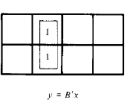
Example 3: State Diagram For Design
Present State |  | Input | Next State |  | Flip Flop Inputs |  | Output
A | B | x | A_{t+1} | B_{t+1} | D_{A} | D_{B} | Y
0 | 0 | 0 | 0 | 0 | 0 | 0 | 0
0 | 0 | 1 | 0 | 1 | 0 | 1 | 1
0 | 1 | 0 | 1 | 0 | 1 | 0 | 0
0 | 1 | 1 | 0 | 1 | 0 | 1 | 0
1 | 0 | 0 | 1 | 0 | 1 | 0 | 0
1 | 0 | 1 | 1 | 1 | 1 | 1 | 1
1 | 1 | 0 | 1 | 1 | 1 | 1 | 0
1 | 1 | 1 | 0 | 0 | 0 | 0 | 0

Slide 75
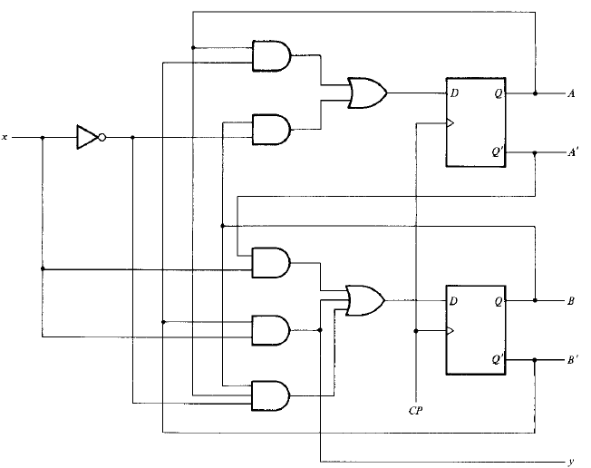
Example 3: State Diagram For Design

Slide 76
Design of Counters

Slide 77
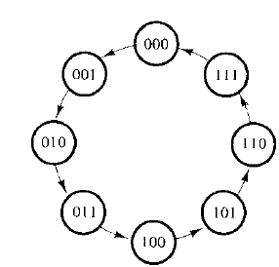
Counters
An n-bit binary counter consists of n flip-flops
Can count in binary from 0 to 2^{n}-1
Here is a state diagram of 3-bit binary counter
Next state of the counter depends entirely on its present state
State transition occurs every time a pulse occurs

Slide 78
Example 1: Design of Counters
Design the counter with the following state diagram with T flip-flop/
Design a 3-bit binary counter with T flip flop

Slide 79
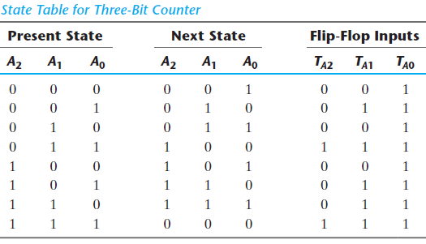
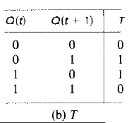
Example 1: Design of Counters
Design the counter with T flip-flop

Slide 80
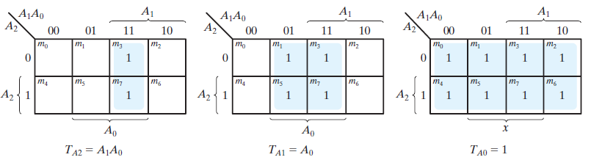
Example 1: Design of Counters

Slide 81
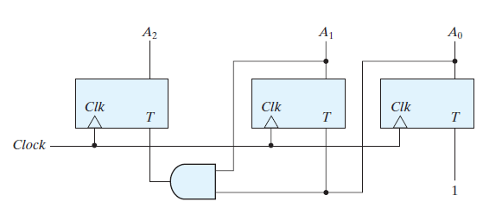
Example 1: Design of Counters

Slide 82
Example 2: Design of Counters
Design the counter with the following state diagram with JK flip-flop/
Design a 3-bit binary counter with JK flip-flop

Slide 83
Example 2: Design of Counters
Present State |  |  | Next State |  |  | Flip Flop Inputs
A | B | C | A | B | C | J_{A} | K_{A} | J_{B} | K_{B} | J_{C} | K_{C}
0 | 0 | 0 | 0 | 0 | 1 | 0 | X | 0 | X | 1 | X
0 | 0 | 1 | 0 | 1 | 0 | 0 | X | 1 | X | X | 1
0 | 1 | 0 | 0 | 1 | 1 | 0 | X | X | 0 | 1 | X
0 | 1 | 1 | 1 | 0 | 0 | 1 | X | X | 1 | X | 1
1 | 0 | 0 | 1 | 0 | 1 | X | 0 | 0 | X | 1 | X
1 | 0 | 1 | 1 | 1 | 0 | X | 0 | 1 | X | X | 1
1 | 1 | 0 | 1 | 1 | 1 | X | 0 | X | 0 | 1 | X
1 | 1 | 1 | 0 | 0 | 0 | X | 1 | X | 1 | X | 1

Slide 84
Example 2: Design of Counters
A₁A₀
00
01
11
10
A₂
Present State |  |  | Next State |  |  | Flip Flop Inputs
A | B | C | A | B | C | J_{A} | K_{A} | J_{B} | K_{B} | J_{C} | K_{C}
0 | 0 | 0 | 0 | 0 | 1 | 0 | X | 0 | X | 1 | X
0 | 0 | 1 | 0 | 1 | 0 | 0 | X | 1 | X | X | 1
0 | 1 | 0 | 0 | 1 | 1 | 0 | X | X | 0 | 1 | X
0 | 1 | 1 | 1 | 0 | 0 | 1 | X | X | 1 | X | 1
1 | 0 | 0 | 1 | 0 | 1 | X | 0 | 0 | X | 1 | X
1 | 0 | 1 | 1 | 1 | 0 | X | 0 | 1 | X | X | 1
1 | 1 | 0 | 1 | 1 | 1 | X | 0 | X | 0 | 1 | X
1 | 1 | 1 | 0 | 0 | 0 | X | 1 | X | 1 | X | 1
 |  | 1
X | X | X | X
JA = A₁A₀
A₁A₀
00
01
11
10
A₂
X | X | X | X
 |  | 1
KA = A₁A₀

Slide 85
Example 2: Design of Counters
A₁A₀
00
01
11
10
A₂
Present State |  |  | Next State |  |  | Flip Flop Inputs
A | B | C | A | B | C | J_{A} | K_{A} | J_{B} | K_{B} | J_{C} | K_{C}
0 | 0 | 0 | 0 | 0 | 1 | 0 | X | 0 | X | 1 | X
0 | 0 | 1 | 0 | 1 | 0 | 0 | X | 1 | X | X | 1
0 | 1 | 0 | 0 | 1 | 1 | 0 | X | X | 0 | 1 | X
0 | 1 | 1 | 1 | 0 | 0 | 1 | X | X | 1 | X | 1
1 | 0 | 0 | 1 | 0 | 1 | X | 0 | 0 | X | 1 | X
1 | 0 | 1 | 1 | 1 | 0 | X | 0 | 1 | X | X | 1
1 | 1 | 0 | 1 | 1 | 1 | X | 0 | X | 0 | 1 | X
1 | 1 | 1 | 0 | 0 | 0 | X | 1 | X | 1 | X | 1
 | 1 | X | X
 | 1 | X | X
JB= A₀
A₁A₀
00
01
11
10
A₂
X | X | 1
 | 1 | X | X
KB = A₀

Slide 86
Example 2: Design of Counters
A₁A₀
00
01
11
10
A₂
Present State |  |  | Next State |  |  | Flip Flop Inputs
A | B | C | A | B | C | J_{A} | K_{A} | J_{B} | K_{B} | J_{C} | K_{C}
0 | 0 | 0 | 0 | 0 | 1 | 0 | X | 0 | X | 1 | X
0 | 0 | 1 | 0 | 1 | 0 | 0 | X | 1 | X | X | 1
0 | 1 | 0 | 0 | 1 | 1 | 0 | X | X | 0 | 1 | X
0 | 1 | 1 | 1 | 0 | 0 | 1 | X | X | 1 | X | 1
1 | 0 | 0 | 1 | 0 | 1 | X | 0 | 0 | X | 1 | X
1 | 0 | 1 | 1 | 1 | 0 | X | 0 | 1 | X | X | 1
1 | 1 | 0 | 1 | 1 | 1 | X | 0 | X | 0 | 1 | X
1 | 1 | 1 | 0 | 0 | 0 | X | 1 | X | 1 | X | 1
1 | X | X | 1
1 | X | X | 1
JC= 1
A₁A₀
00
01
11
10
A₂
X | 1 | 1 | X
X | 1 | 1 | X
KC = 1

Slide 87
Example 2: Design of Counters
Functions for 3-bit binary counter with JK flip flop
JA = A₁A₀
JB= A₀
JC= 1
KA = A₁A₀
KB = A₀
KC = 1

Slide 88
Self Study
Exercises from chapter 6:
6-14,6-15,6-16

